Slide 1
Class Diagrams

Slide 2
Objectives
What is a class diagram and what is its purpose?
Components of a Class diagram?
How do we develop a Class Diagram?
How is a Class Diagram related to other UML diagrams?

Slide 3
Unified Modelling Language (UML)
Developed in the mid-90s by Grady Booch, Ivar Jacobson and James Rumbaugh
  First draft published in 1997
  UML 2.0 published in 2005
  UML 2.5 published in 2015
Brings together numerous modelling methods
Primarily aimed at Object-Oriented Analysis and Design
Includes things like Use Case Diagrams, Activity Diagrams and Class Diagrams
Widely used and understood

Slide 4
What is a Class Diagram
Class diagrams are used to show
  A static structural view of a system
  The relationships between types of objects in the system (Hierarchy and Structure)
  The types of objects that will be created in the system
  Object attributes
  Object operations/methods that they carry out
  Original notations for ERDS are becoming less popular – most likely will see ERDs represented by UML Class Diagrams
  Class Diagram = ERD + Object-Oriented Components

Slide 5
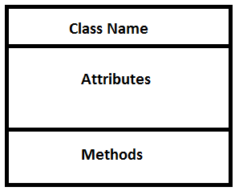

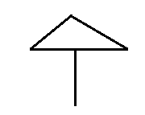
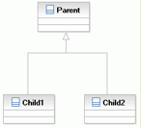

Class Components
Class
Association
Generalisation
Multiplicities
Dependencies
Aggregation
Composition

Slide 6
Representing a Class
A class is represented with a rectangular box
Each class has three sections:
  Class name
  Attributes
  Methods/Operations
Attributes are information we store about the class
Methods/Operations are things the class can do
Operations are optional in the diagram for database classes
Class name
Planet
Planet_name: string
Planet_size: int
Attributes
mineResources(): int
Operations

Slide 7
Class Attributes
Attributes are pieces of information stored about the class
  Can think of them as variables in an object
Standard syntax is:
visibility name : type multiplicity {properties}
Resource
Name : string
Amount : int

Slide 8
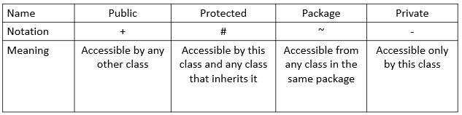
Attribute visibility
Resource
+ Name : string
# Amount : int

Slide 9
Multiplicity
visibility name : type multiplicity {properties}
Sometimes attributes may have many instances
  e.g. a planet may have many resources
Specify the multiplicity inside square brackets
A single integer means exactly that many instances
  e.g. [4] wheels on a car
  Default for all attributes is 1
A range is shown with two dots: [min..max]
An infinite range is shown with a *: [min..*]
* on its own means zero or more
Ship
+ name : string
- max_speed : int [800]

Slide 10
Attribute Properties
visibility name : type multiplicity {properties}
Within curly brackets (braces) we can specify any number of properties
  e.g. {Read Only}, {static}
Can also specify constraints
  e.g. {not null}
Ship
+ name : string
- max_speed : int [800] {not null}

Slide 11
Class operations/methods
Ship
+ name : string
- max_speed : int [800] {not null}
Operations specify the behaviour of a class
  Can think of them as functions of the object
Standard syntax is:
visibility name(parameters) : return-type {properties}
Visibility and properties same as for class attributes
Parameters are attributes and have the same syntax as class attributes
Database classes usually don’t have operations
+ move(): int
+ fire(): int

Slide 12
Relationships Between Classes
In a class diagram we will probably have many classes
Want to show how different classes relate to each other
Different relationships:
  Dependency
  Association
  Aggregation
  Composition
  Generalisation

Slide 13
Multiplicity
MULTIPLICITY/Degree of Relationship | SHOWN AS
One or many | 1..*
Zero, one or many | 0..* or just *
Zero or one | 0..1
Precisely one | 1 (or omitted)
Precisely a number | e.g. 2 or 5 or 19
Range of numbers | e.g. 3..7, 4..*
 | Entity Model | Class Diagram
Degree of relationship e.g. 1:M, M:N etc | Many is represented by a crows foot | Shown as actual number
Optional relationship | Dotted line | Shown by a zero
Mandatory relationship | Solid line | Shown by 1

Slide 14
Associations
Shows that two classes are related to each other
Say that one class “has” the second class
  A planet has a resource/has resources
Associations indicate a long-term relationships
Associations can have names
Planet
Resource
+ Planet_name : string
- Planet_size : int
Contains
+ Name : string
# Amount : int
+ mineResources(): int

Slide 15
Association Multiplicities
As with in-line attributes we can add multiplicities to associations
No need for brackets this time
Here one planet has zero or many resources
Planet
Resource
+ Planet_name : string
- Planet_size : int
Contains
+ Name : string
# Amount : int
1
0..*
+ mineResources(): int

Slide 16
Association class
The link table in object oriented is know as an Association class, this may have been discovered using normalisation
Normalisation removes duplication, class diagrams are allowed to contain un-normalised relations if they correspond to the user’s view of the system
Course
+Course Code
-Course Title
Enrolled on
Student
+Student Number
-Student Name
studies
Module
+Module Code
-Module Title
1 0..*
0..* 1..*
Module
Enrolment
+Grade

Slide 17
Dependency
Shows that one class relies on another
Say that one class “uses” the second class
  Ships use resources
Dependencies indicate short-term relationships
Ship
Resource
+ name : string
- max_speed : int
+ Name : string
# Amount : int
+ move(): int
+ fire(): int

Slide 18
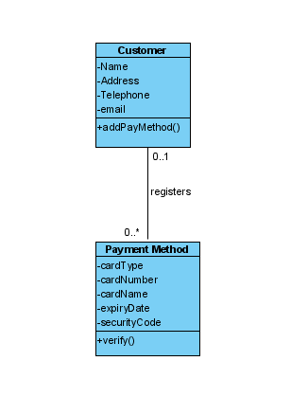
Example Class Diagram
1

Slide 19
Generalisation (Inheritance)
Shows that one class is a specific version of another
Say that one class “is a” second class
  A Cargo Ship is a Ship
Generalisation is the UML version of Inheritance
Ship
+ ship_name :string
+ move(): int
+ fire(): int
CargoShip
AttackShip
+ holdSize :int
+ Armour : int
+ FirePower:int

Slide 20
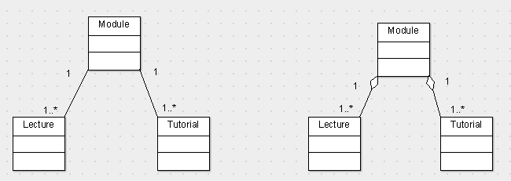
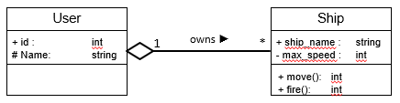
Aggregation
Occurs when one class consists of more than one instance of another class.
The child can still exist independently of the parent
A module is made up of lectures and tutorials, these lectures/tutorials can still exist if the module is deleted as they could be used for another module
Association
Aggregation

Slide 21
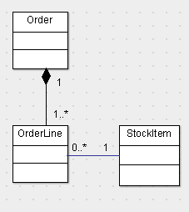
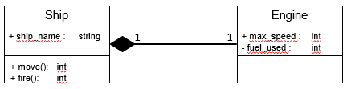
Composition
A form of aggregation with strong ownership so when the composite is deleted, its constituent parts go with it, child cannot exist without the parent

Slide 22
Creating Class Diagrams
When implementing for a programming language
Identify Classes
  Noun phrases (person, place or thing?)
  Do we store data about it?
  Does it carry out operations?
  Check: If it has no attributes or no operations then is it really a class?
Identify Attributes and Operations (optional)
Identify associations & multiplicities
Note: Take care with Generalisation
Implementing for a database design
Identify the nouns
Decide which nouns are classes and which are attributes
Draw the classes and attributes
  Add other appropriate attributes
Choose or create appropriate keys – can include them as properties of attributes
Apply appropriate associations and relationships

Slide 23
Class Diagram Example for Programming
Use case: Place Order
Step 1
Identify classes from a use case:
Is it a noun? Y/N
  Y – could be a class/attribute
  N – not a class/attribute
Does it have attributes? Y/N
  Y – is a class, identify the attributes
  N – not a class
Identify the operations/methods
Retailer views current product catalogue
Retailer creates a new order
Retailer adds items to their order
Order is checked against product catalogue to ensure details are correct

Slide 24
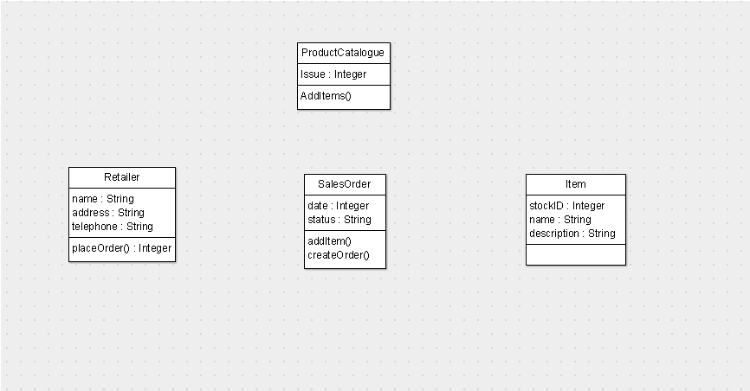
Add classes, Attributes and Operations
Step 2 : Identify relationships and multiplicities

Slide 25
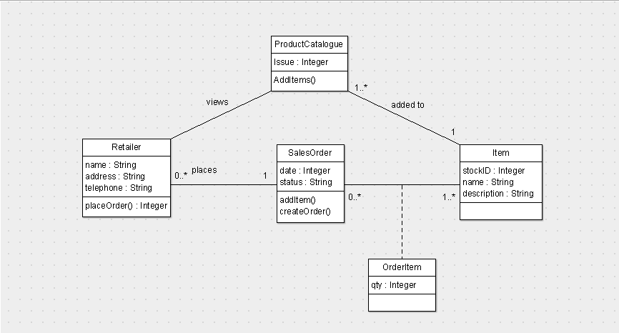
Add Associations and Multiplicities
Associations will help identify operations

Slide 26
Steps & Example for Database Design
Identify the nouns
Decide which nouns are classes and which are attributes
Draw the classes and attributes
  Add other appropriate attributes
Choose or create appropriate keys – can include them as properties of attributes
Apply appropriate associations and relationships

Slide 27
A Space Game in SQL
The game will see players compete for control of planets and their resources. Every player starts off with one home planet and a mining ship capable of mining a planet from space to gather its resources. There are three resources available: fuel, metal and gold. Planets may have no resources or all three (home planets always have all three).
Players will utilise resources to build their fleet, using metal to build ships and planet defences; gold to pay the crew and fuel to fire the engines and weapons. There are three types of ships: mining ships are defenceless, slow hulks that gather resources from a planet. Scout ships are small, lightly armed and fast designed for identifying new planets. Attack ships are well armed and do the fighting. They can attack other ships or conquer planets, but in order to control a planet the ship must land and be converted into a base.
Players are ranked based on the size of their empires – made up of the planets and ships they own.
Step 1 Identify the nouns

Slide 28
Step 1: The Nouns
The game will see players compete for control of planets and their resources. Every player starts off with one home planet and a mining ship capable of mining a planet from space to gather its resources. There are three resources available: fuel, metal and gold. Planets may have no resources or all three (home planets always have all three).
Players will utilise resources to build their fleet, using metal to build ships and planet defences; gold to pay the crew and fuel to fire the engines and weapons. There are three types of ships: mining ships are defenceless, slow hulks that gather resources from a planet. Scout ships are small, lightly armed and fast designed for identifying new planets. Attack ships are well armed and do the fighting. They can attack other ships or conquer planets, but in order to control a planet the ship must land and be converted into a base.
Players are ranked based on the size of their empires – made up of the planets and ships they own.

Slide 29
Step 1: The Nouns
Player
Planet
Resource
Home planet
Mining ship
Fuel
Metal
Gold
Fleet
Planet defence
Crew
Engine
Weapon
Scout ship
Attack ship
Rank
Step 2 Decide which nouns are classes and which are attributes

Slide 30
Step 2: Class or Attribute?
Player – class
Planet – class
Resource – class
Home planet – attribute
Mining ship – class
Fuel – attribute
Metal – attribute
Gold – attribute
Fleet – class?
Planet defence – attribute
Crew – attribute
Engine – attribute
Weapon – attribute
Scout ship – class
Attack ship – class
Rank – attribute
Step 3 Draw the classes and attributes

Slide 31

Step 3: Drawing the Classes
Step 3a Add other appropriate attributes

Slide 32
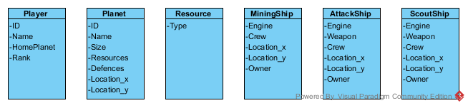
Step 3a: Add Other Attributes
Step 4: Choose or create appropriate keys – can include them as properties of attributes

Slide 33
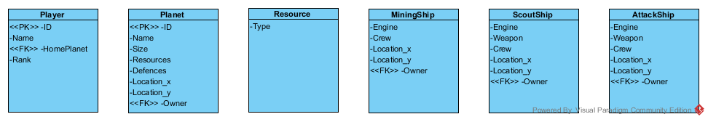
Step 4: The Keys
Step 5: Apply appropriate relationships

Slide 34
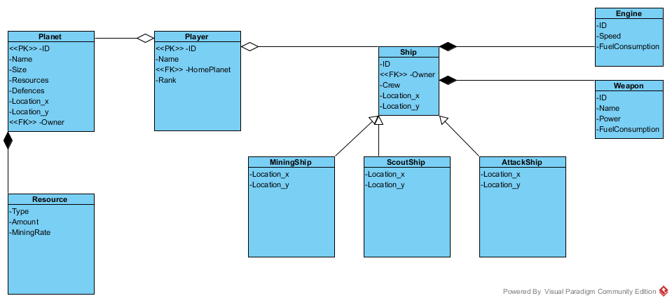
Step 5: Add Relationships
Further modifications to relationships e.g. for each ship identified in the generalisation section, what is the best way to build this in SQL?

Slide 35
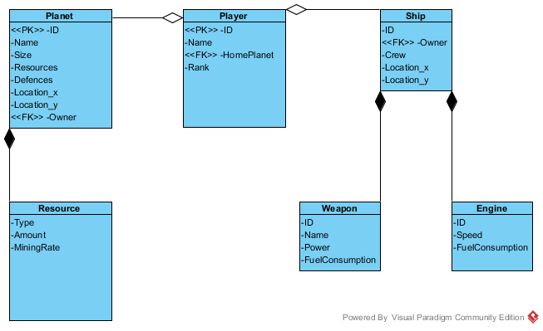
Step 5: Add Relationships
Step 6 Apply multiplicities to the associations

Slide 36
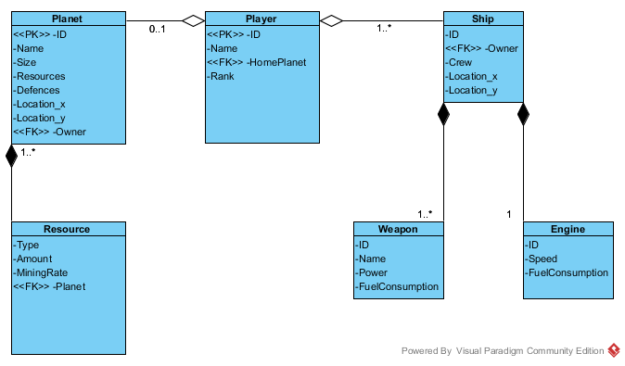
Step 6: Add Multiplicities

